Slide 1
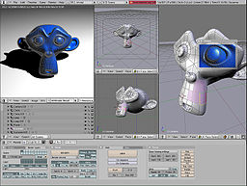
Lecture 1 Introduction to Computer Graphics
Computer graphics are pictures and movies created using computers - usually referring to image data created by a computer specifically with help from specialized graphical hardware and software.

Slide 2
Applications of Computer Graphics
Paint programs
Illustration/design programs
Animation software
CAD software
Desktop publishing
In general, applications that support graphics require a powerful CPU and a large amount of memory. Many graphics applications— This is true of all three-dimensional computer graphics applications.
In addition to the CPU and memory, graphics software requires a graphics monitor and support for one of the many graphics standards. Most PC programs, for instance, require VGA graphics.

Slide 3
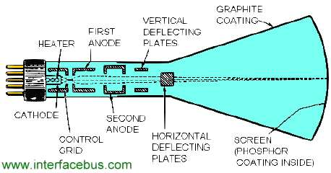
Refresh Cathode-Ray Tubes

Slide 4
Primary Components of an electron gun in a CRT are heated metal cathode and control grid.
Intensity of the electron beam is controlled by setting voltage levels on the control grid.
Amount of light emitted by the phosphor coating depends on the number of electrons striking the screen. Brightness of display can be controlled by varying voltage.
Focusing system is needed.
For Focusing, deflection of the electron beam can be controlled either with electric fields or with magnetic fields.
Spots of light are produced on the screen by the transfer of the CRT beam energy to the phosphor.
Different kind of phosphors are available depending on their persistence (characteristic)

Slide 5
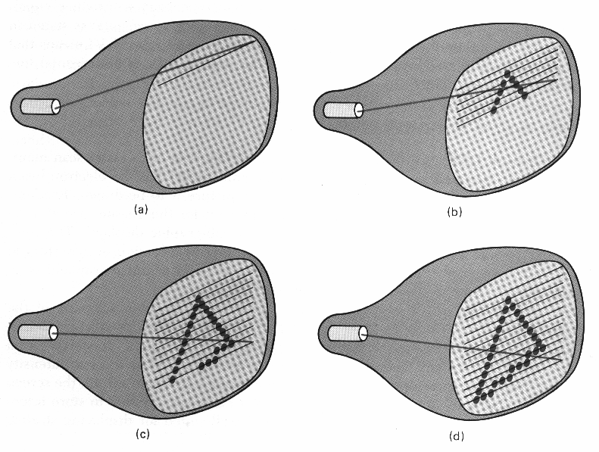
Types of Scans
Raster Scan Displays
Picture definition is
stored in a memory area
called refresh buffer or
frame buffer.
Information is painted on the screen per row, they called scan line.
A system with 24 bits per pixel and a screen resolution of 1024 by 1024 requires 3MB of frame buffer. Frame buffer with scan info is called bitmap. Multiple type of pixels in a sytem are called pixmap.

Slide 6
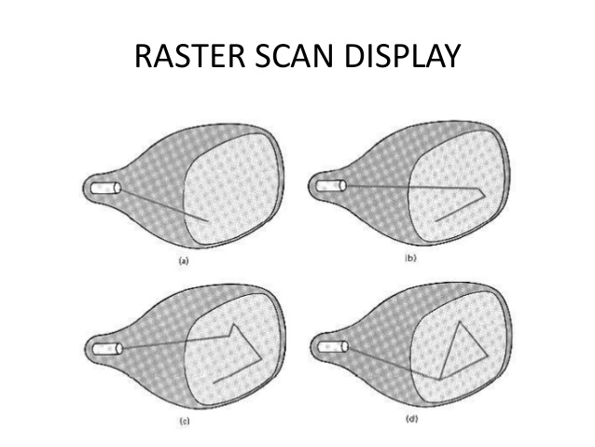
Random-Scan Display
When operated as a random
Scan display unit, a CRT has the
Electron beam is directed only to
the parts of the screen where a
Picture is to drawn.
Randon scan displays are also called vector scan displays.
High quality vector systems are capable of handling approximately 1,00,000 short lines.
Random-scan systems are designed for line drawing applications and can not display shaded scenes.
This display has higher resolution than raster scan system.
Random scan produces smooth lines and raster scan produces jagged lines.

Slide 7
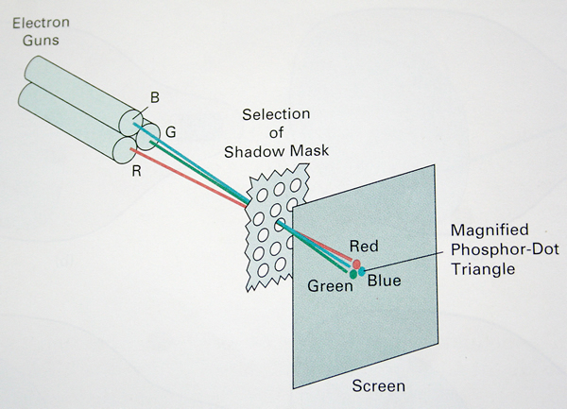
Shadow Mask CRT
Shadow mask methods are commonly
Used in raster-scan systems (including
Color TV) because they produce a much
Wider range of colors than beam
penetration method. A shadow mask
CRT has three phosphor color dots at
each pixel position. One phosphor
dot emits a red light, another emits green
light and third emits a blue light. Three
Electron guns are there one for each color

